Slide 1

The Open Memo

Slide 2

Planning your time
Today is Tuesday 10/20. The memo is due 11/8. How should you use your time over the next 3 weeks?

Slide 3
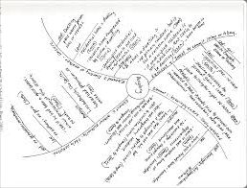

GOALS FOR THIS WEEK- THE RULES
Research
Outline

Slide 4
Problem Analysis

Slide 5
Step 1: Browse
After some initial gathering, identify the governing rules.
(1) look for language that gets repeated across different cases;
(2) see how the courts define things and what sways them.

Slide 6
Find Binding Primary Legal Authorities to Formulate Both the General and Specific Rules for Your Issue
General rules – set forth the overarching framework governing your issue, likely listing the elements, factors, burdens, etc. that a party must prove to prevail.
  For example, authority for our four elements and how the two you on which you are supposed to work with interact with each other.
Specific rules – provide deeper, more particular definitions, elements, factors, or significant facts as to some part of the general rule.
  For example, how does financial interest of the defendant impact a finding of malice?

Slide 7
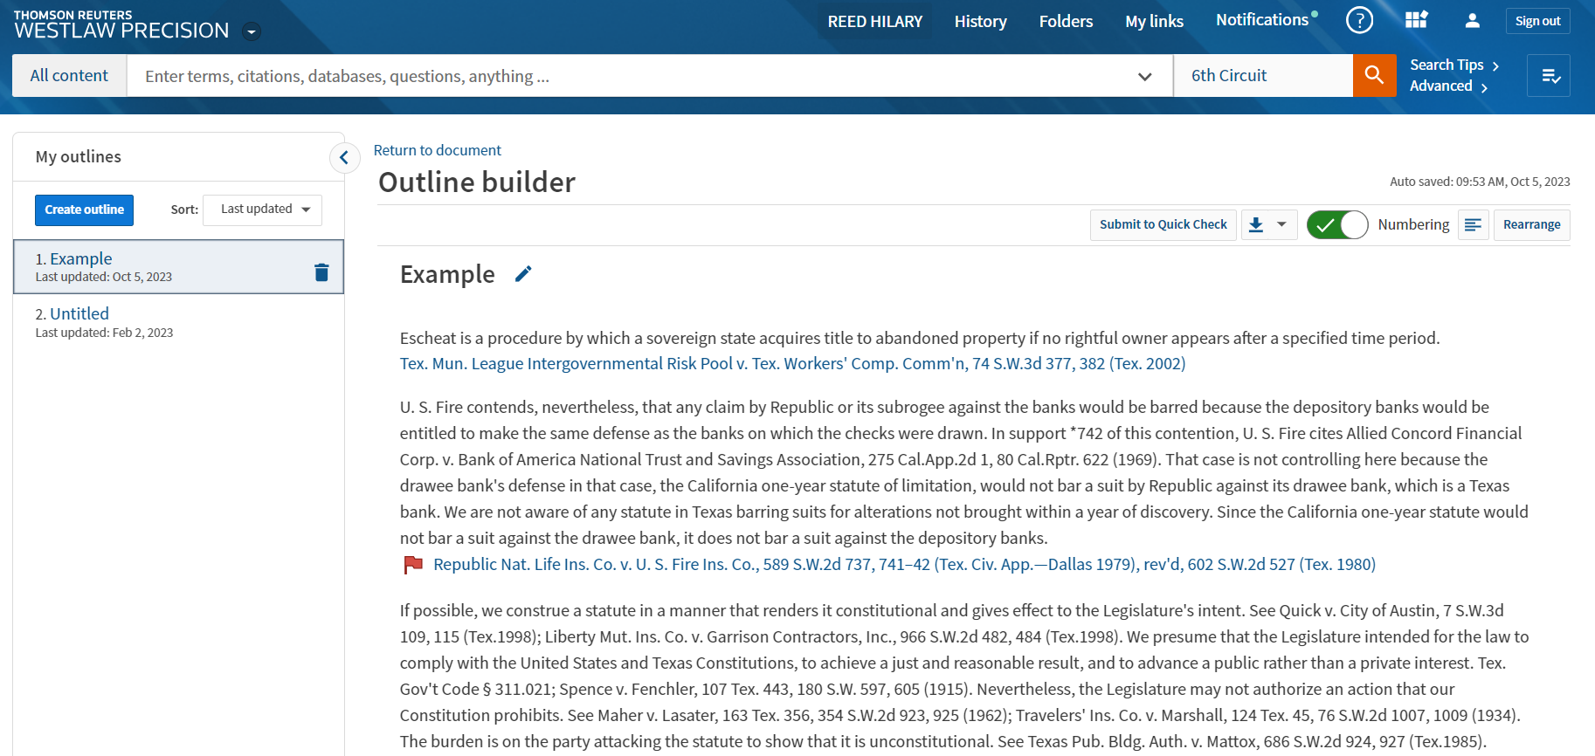
Outlining Tool

Slide 8
If you can’t find anything
Do you understand the problem?
Re-think your search terms
Go back to secondary sources
Reread the partner memo and see if there is anything that you are missing.

Slide 9
What to do if you find too much
The same principles apply:
Do you understand the problem?
Can your narrow your search terms and/or filter within results?
Search with subject indexes rather than free text searching
Go back to secondary sources

Slide 10
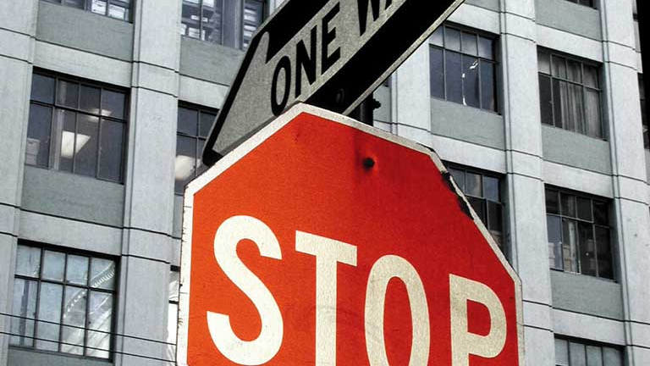
Knowing when to stop

Slide 11
Knowing When to Stop
You know the rules - both general and specific.
You know how the rule has been applied and why cases go in different directions.
You have cite-checked all authorities and analyzed the citing cases.
You start seeing the same cited cases over and over.

Slide 12
Step 2: organize

Slide 13
Chart the Cases with Specificity- Malice Element
Malice Rule Text
 | Fox v. Aperture | Comparable Case 1 (include citation) | Distinguishable Case 1 (include citation)
Element illustrated | All four
Court | To be decided
Underlying proceeding | Criminal, felony theft
Interest the defendant had | [incentive in prosecuting]
Was that interest served only by catching the right person? | Incentive alignment
Documentary motive evidence
Did the defendant misstate anything?
Personal animus toward the accused
Posture
Outcome on malice | To be argued

Slide 14
What Cases Should I Use?

Slide 15
May I use cases only for my rules statement but then not use them for case illustrations?
Yes.
Often cases state the rules well but are not otherwise helpful. It is okay to cite cases in your rules statement that you do not otherwise cite in the rest of your memo.

Slide 16
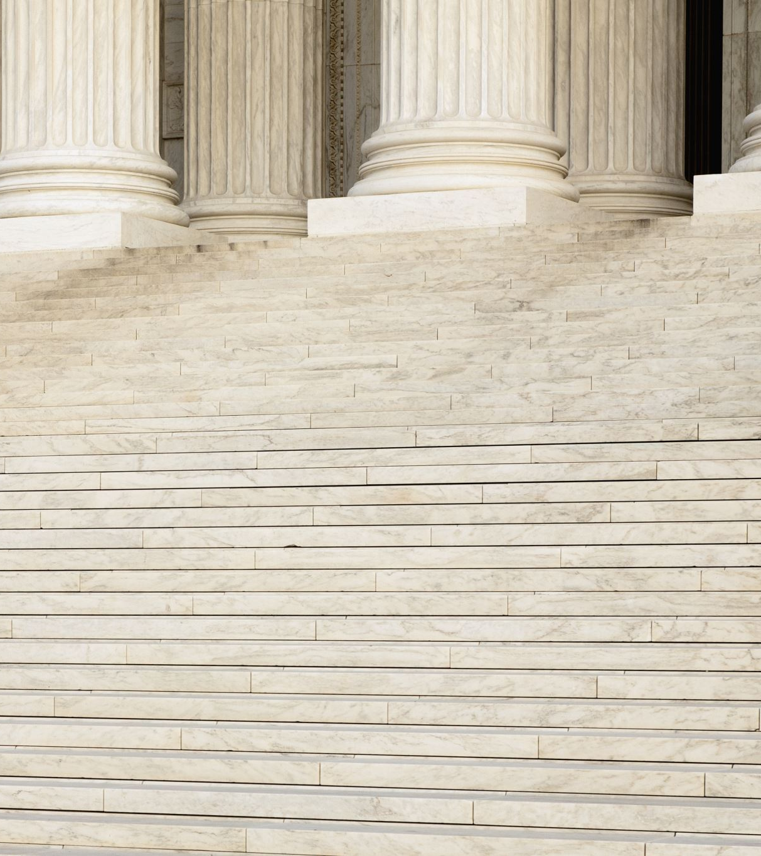
How do I choose what cases to illustrate?
Factual similarity
Binding court
Recency

Slide 17
How many cases do I need?
You need at least one comparable case illustration and one distinguishing case illustration for each element.
The goal is to find a home for every key fact relating to your issue. Chart our facts first – then make sure each major fact is addressed by at least one case.
Use your best judgment but make sure to give a complete and thorough analysis.

Slide 18
Research Report
What law governs here, and what type of cases are binding?
What is a good authority you’ve found for your highest-level governing rule/legal principle? Give a full, proper Bluebook Cite.
For each element, give at least 3 cases and what facts from them line up with your facts.
Is this a case you are considering using as a full illustration, short illustration or parenthetical?
CASE CITATION | RELEVANT FACTS | HOW MIGHT YOU USE IT?

Slide 19
Homework
ICW 12, ICW 13, and ICW 15 due at 5 p.m. Sunday, 10/25. See special instructions posted in the Week 9 Module.
Research Report is due in Canvas, Monday on 10/26 at 5 PM. Research report conferences will be scheduled throughout the week of 10/26.

Slide 20
Extended Office Hours This Week
Today: 4-5 in person (342L)
Thursday: 4-5 in person (342L)
Friday:2-4 in person (342L) or on Zoom

